Slide 1
Isotopes.au Team Meeting
CSIRO & ANSTO & GA & Lithodat

Slide 2
Main Goal of Today’s Meeting:
Understanding the Adapter Development Process
The adapters need to implement a lot of expert knowledge. Next slides will show with a concrete example how the knowledge can be transferred from the experts to the developers.

Slide 3


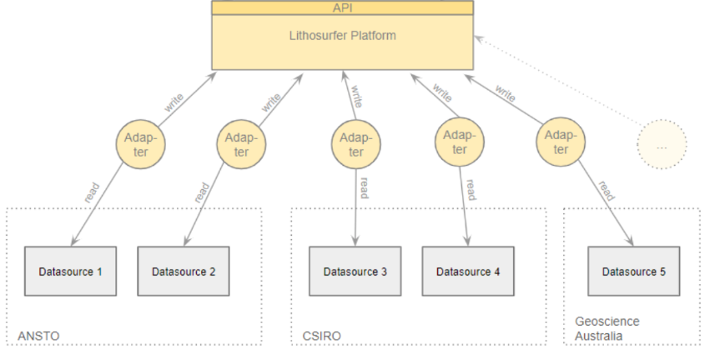
Overview
isotopes.au ontology
Speci- fication

Slide 4
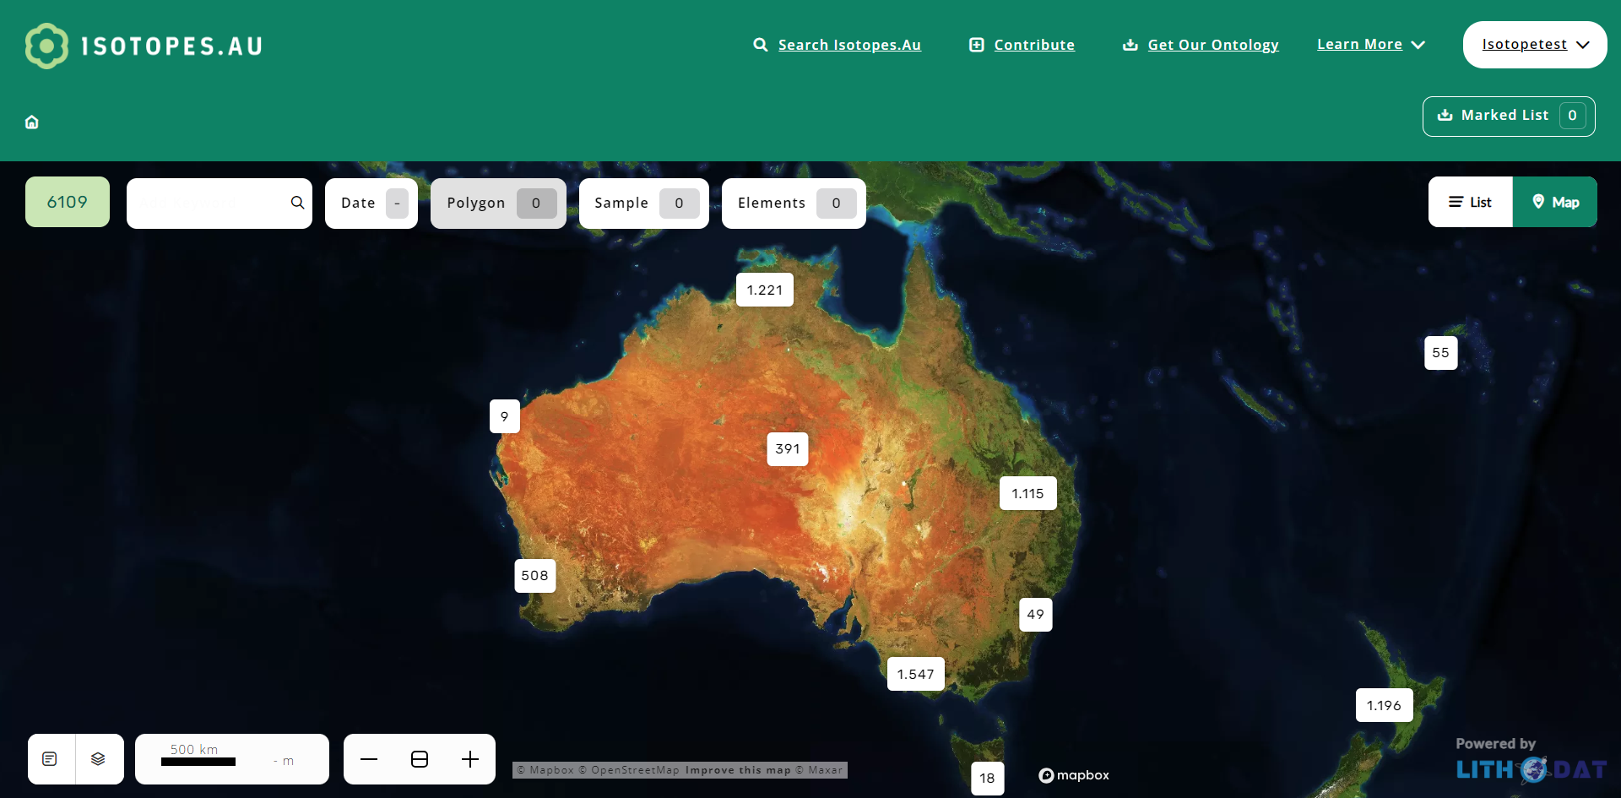
Speci- fication

Slide 5
Overview
Speci- fication
Technicals
Mappings

Slide 6

Overview
reads
Speci- fication
Coder
implements
Coder releases version when finished.

Slide 7
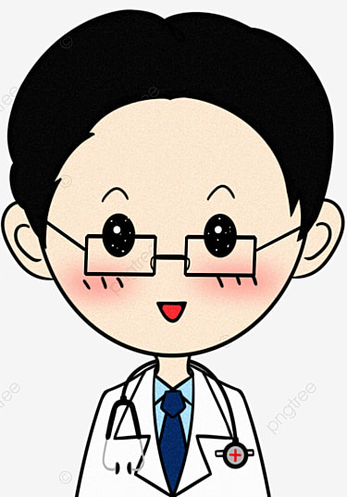
isotopes.au ontology
updates
compares
Speci- fication
Expert

Slide 8


isotopes.au ontology
updates
compares
Speci- fication
Expert
reports issue
Lian F.
Bug-
tracker

Slide 9
Overview
reads
Speci- fication
Coder
implements
reads
Bug-
tracker

Slide 10
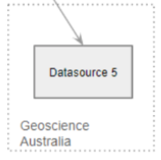
Let’s Exercise an Expert Feedback Round
What the expert needs:
Expert
isotopes.au ontology
output
Speci- fication

Slide 11
Let’s Exercise an Expert Feedback Round
How to update the spec:
feedback
Lian
edits
Expert
comments
isotopes.au ontology
output
Speci- fication

Slide 12
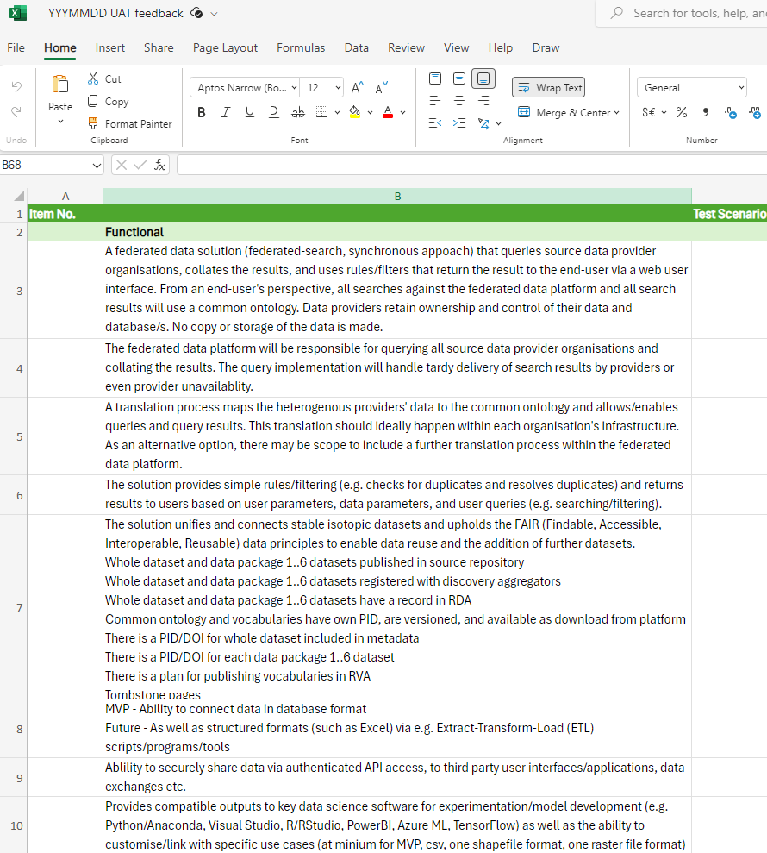
Feedback Formular

Slide 13
Thanks!

Slide 14
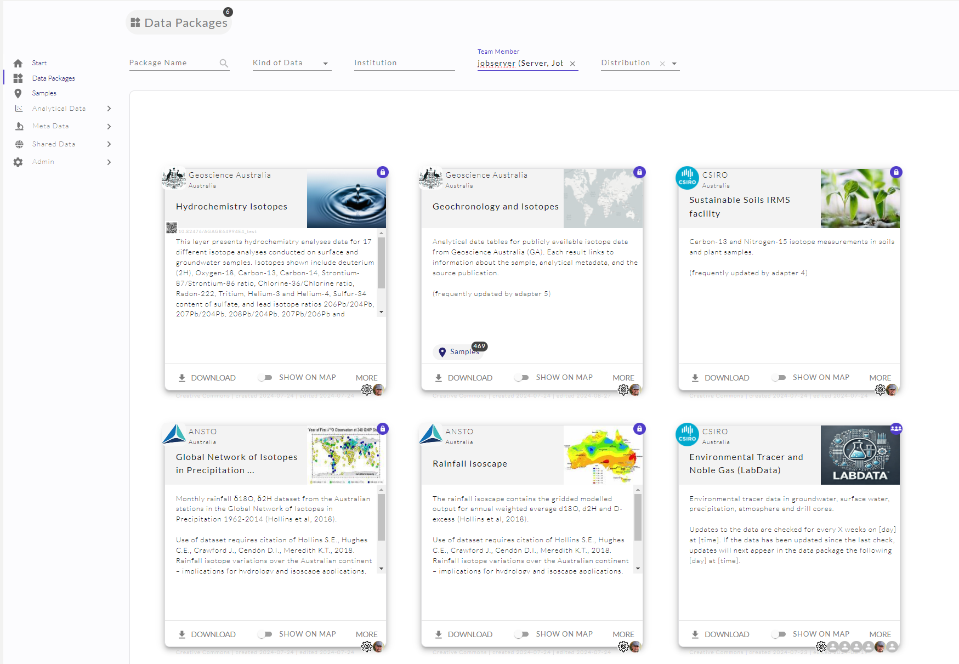
Current State
Technically Working
Ready for Production

Slide 15
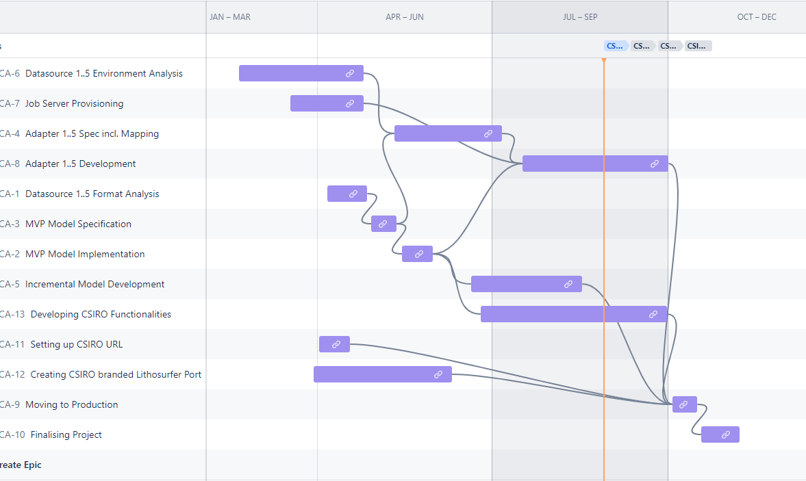
Lithodat internal Timeline
Adapter 3
A. 5
A. 6
A. 2
A. 4
A. 1

Slide 16
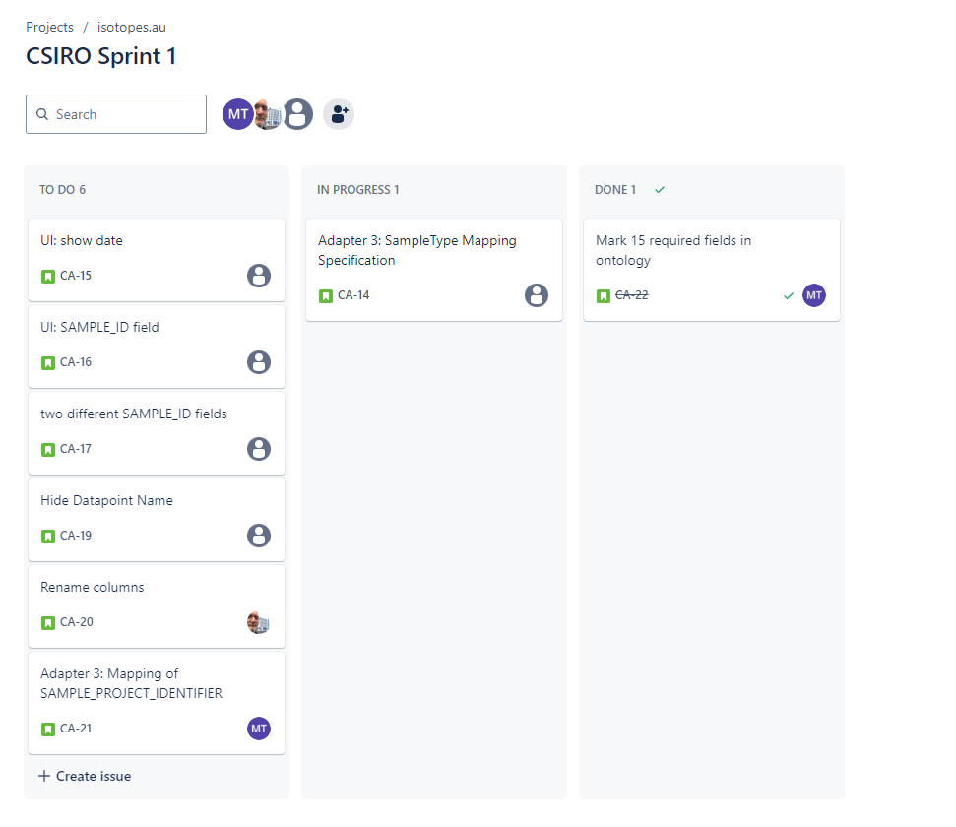
All Feedback and Issues can be managed in Jira

Slide 17
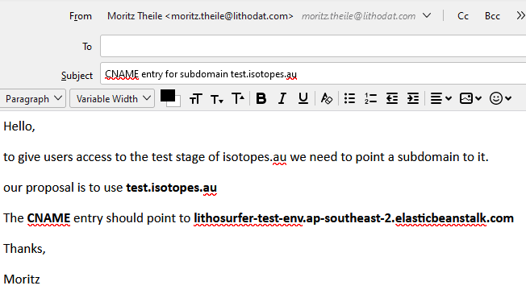
Send Mails with instructions
Who are the recipients?

